Slide 1
Making a pisca XML by hand
2023-08-07

Slide 2
Copy number data
In our lab, we tend to use an R package called ‘ACE’
This generates ABSOLUTE copy number (ie. Not allele specific, just a single number at each ‘bin’ agnostic to which chromosomes have been amplified.

Slide 3
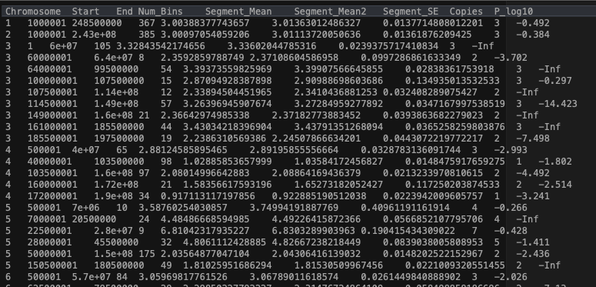
ACE outputs a ‘segments.txt’ file for each sample

Slide 4
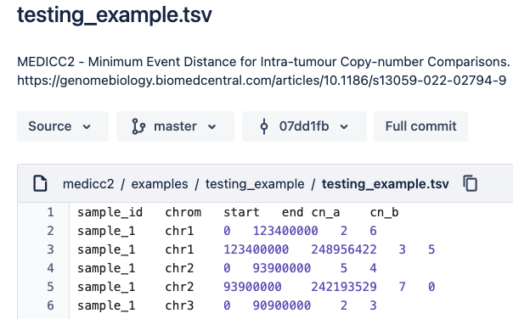
You can also have allele specific copy number, like this:
But this type of data is not available with ’lowpass’ assemblies because the coverage is too low to distinguish cn_a and cn_b

Slide 5
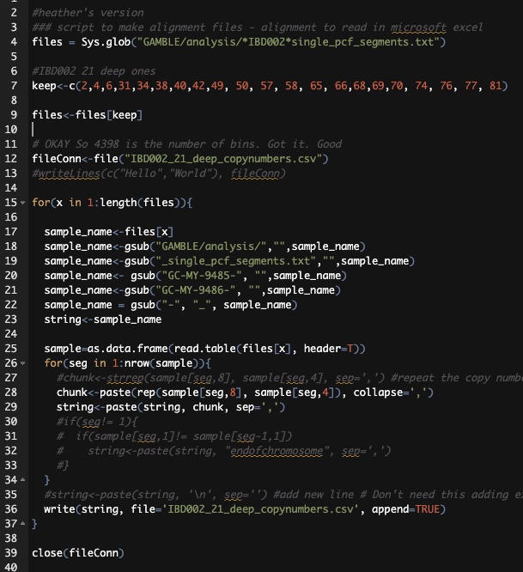
Read into R > make into a csv file IBD002_21_deep_copynumbers.csv

Slide 6
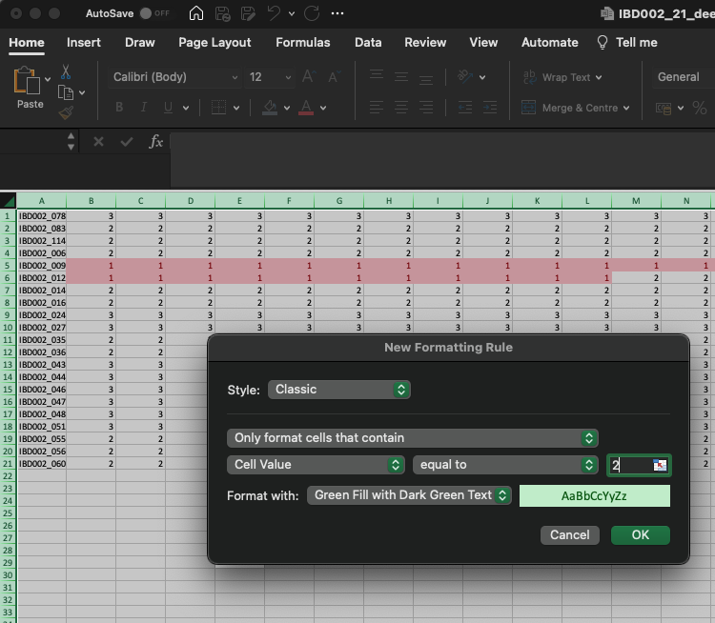
Read the csv into EXCEL and format edit so the numbers are readable

Slide 7
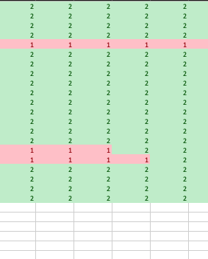
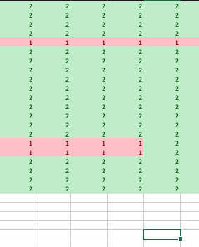
Align the file by eye

Slide 8
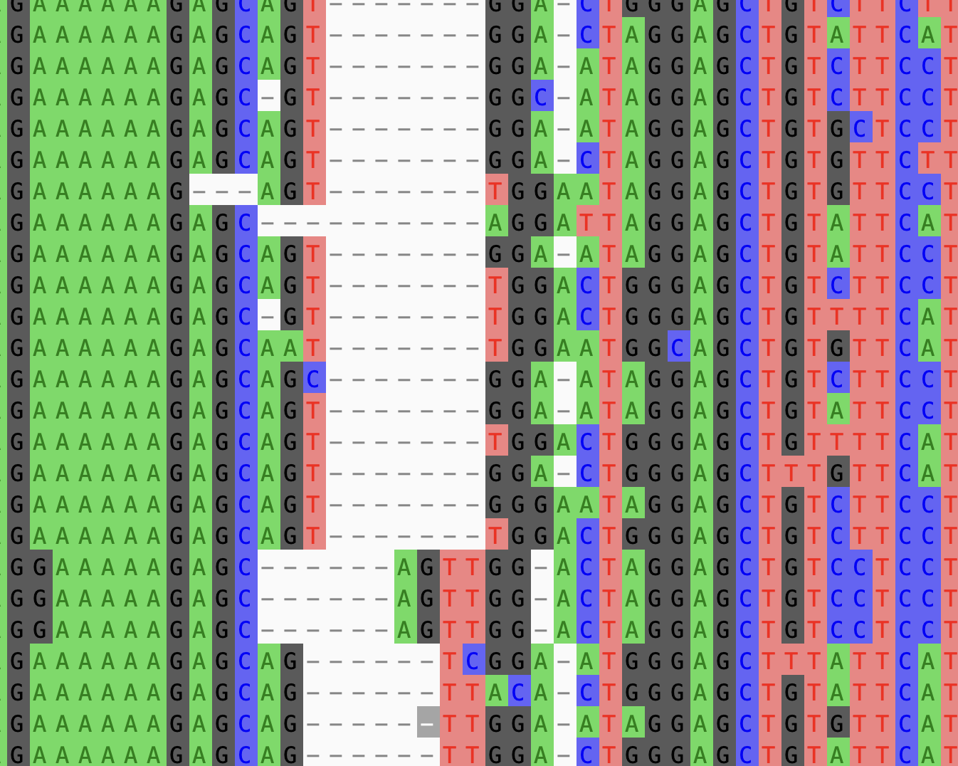
Note: in ”normal” phylogenetics there are tools to make this step easier
HIV example:
GUI Program such as Ali-view / geneious
Move the nucleotides to make the best evolutionary model of the data
(The idea is that each column represents the same nucleotide position through time)

Slide 10
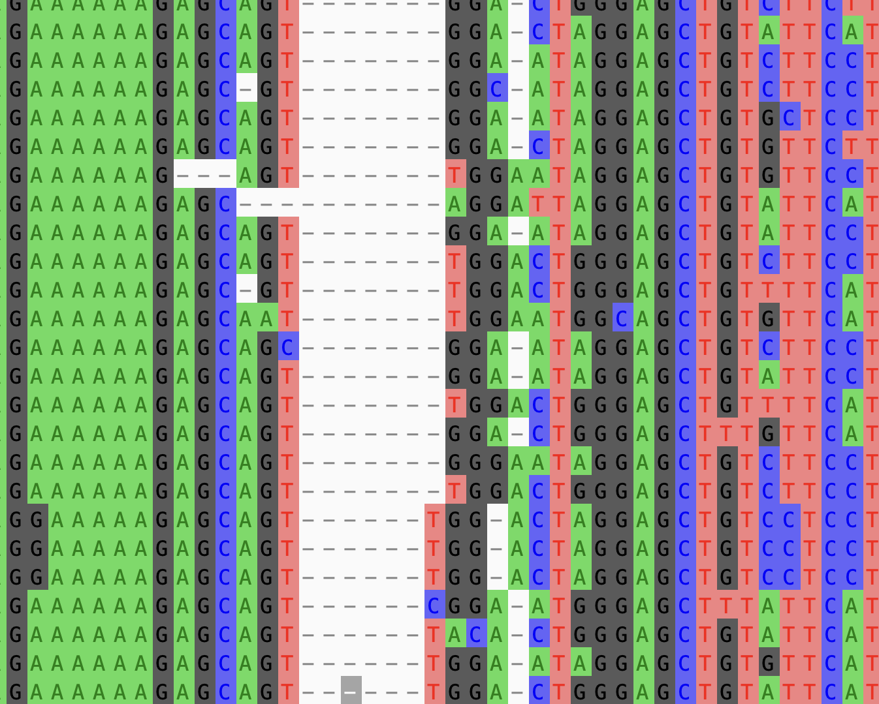

Slide 11
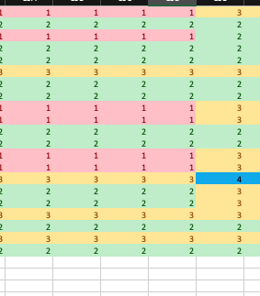
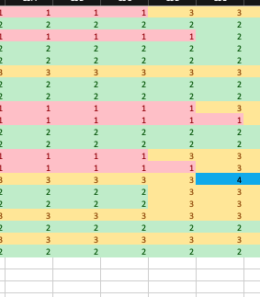
Align file by eye
In this case, I’m assuming that there is error in the location of the copy number estimation, rather than three independent breaks in different samples

Slide 12
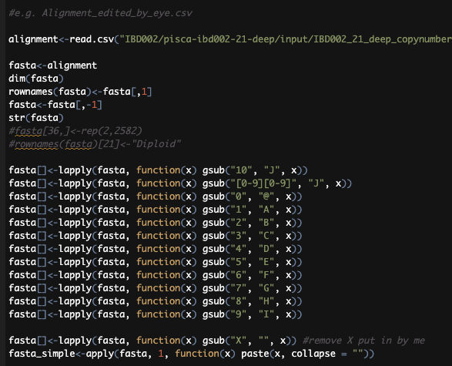
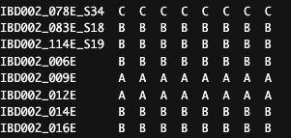
R script to convert csv alignment into a dataframe of letters
Where B == 2 or diploid part of the genome etc.

Slide 13
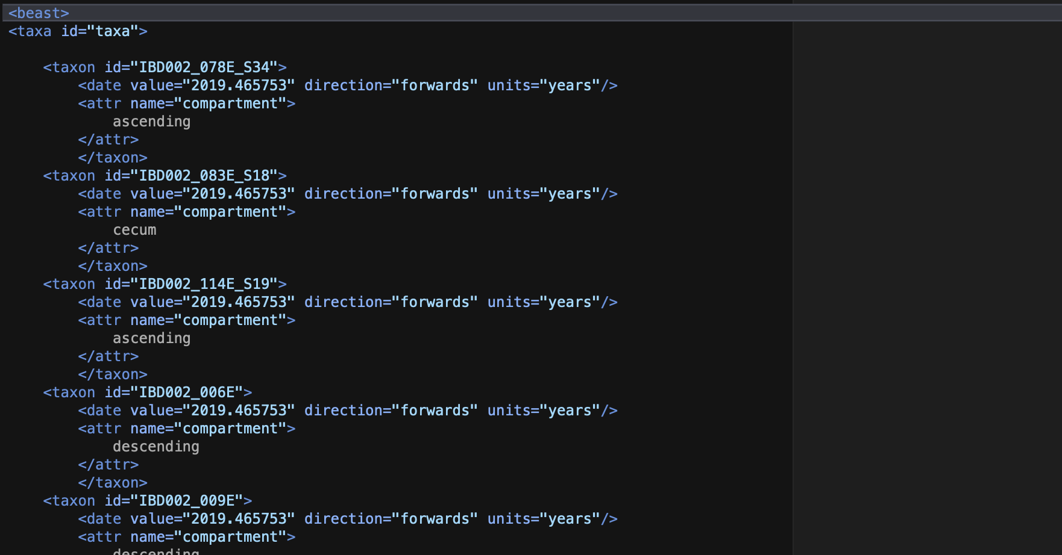
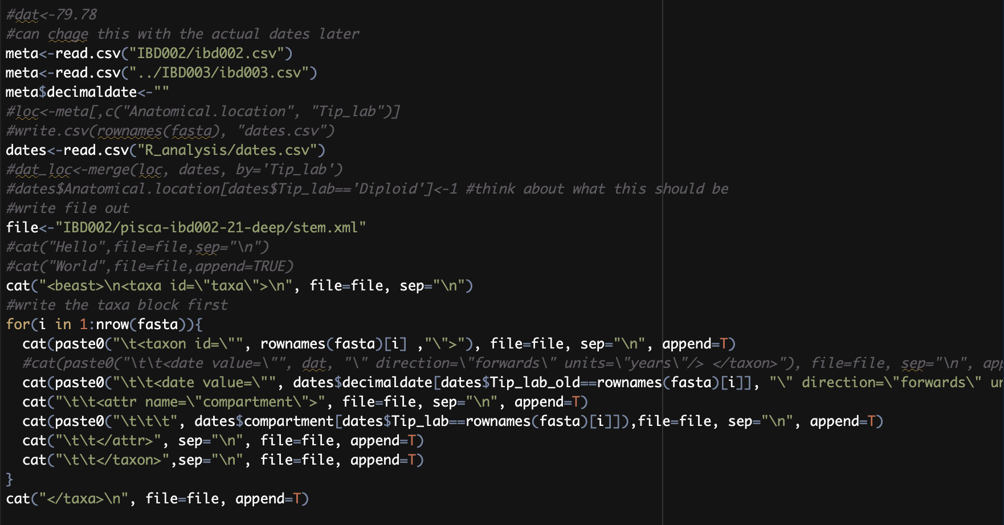
R script adds in dates from a csv file Write out the taxa block
Bonus – added ‘trait’ called “compartment”

Slide 14
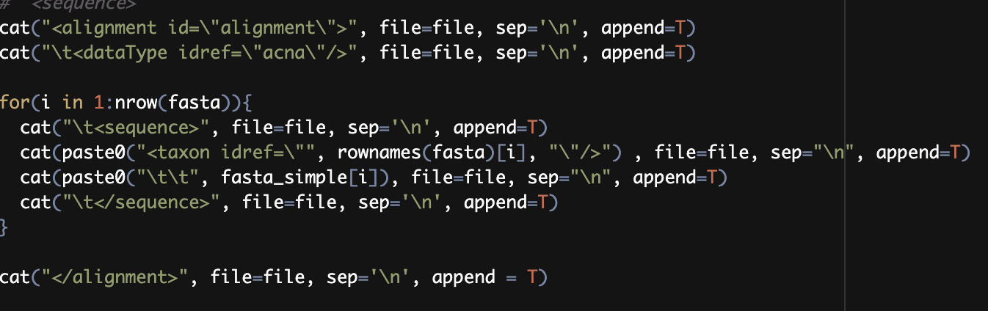
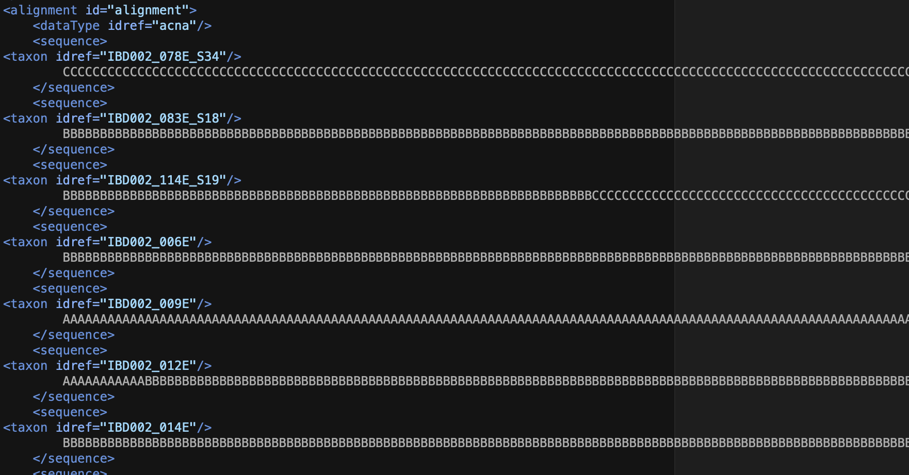
R script writes out the alignment block

Slide 15
Stem.xml
R script writes the
Taxa block
Alignment block
Output to stem.xml

Slide 16
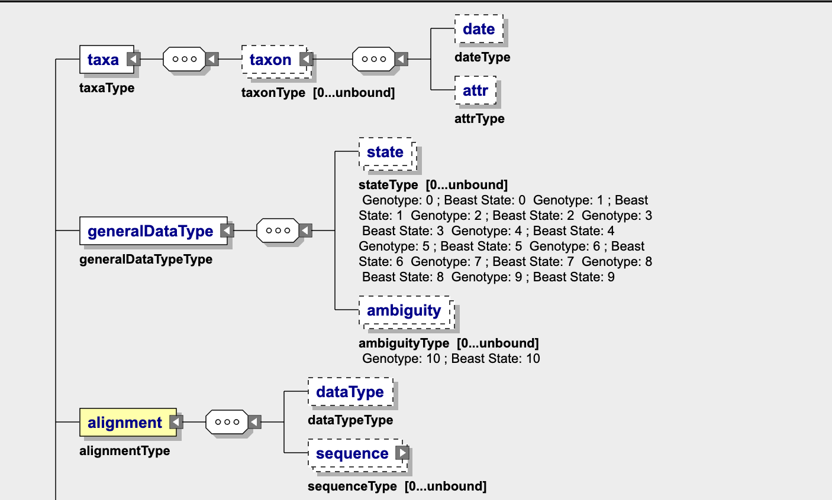
Example 1 strict clock with constant pop size
Copy/paste newly generated taxa block
generalDataType pasted unchanged
Copy/paste newly generated alignment block

Slide 17
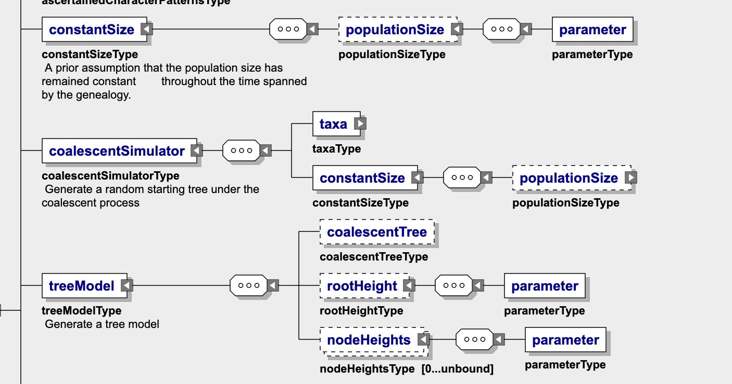
Example 1 strict clock with constant pop size
Copy paste constant size block
Coalescent simulator (make sure constant size linked as above)
Tree model copy paste as is

Slide 18
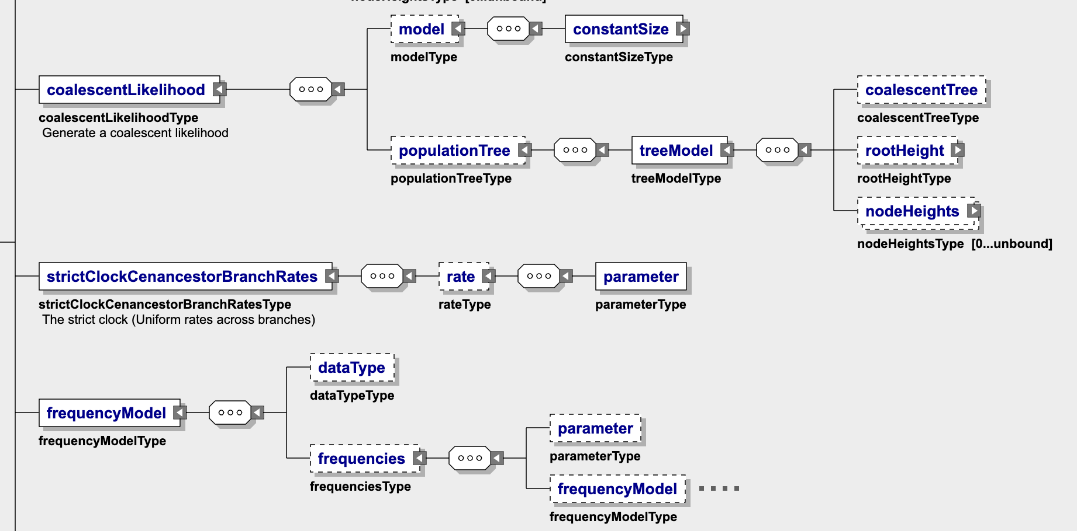
Example 1 strict clock with constant pop size
Coalescent likelihood (make sure constantsize model)
Strictclock copy/paste
Freq model copy/paste

Slide 19
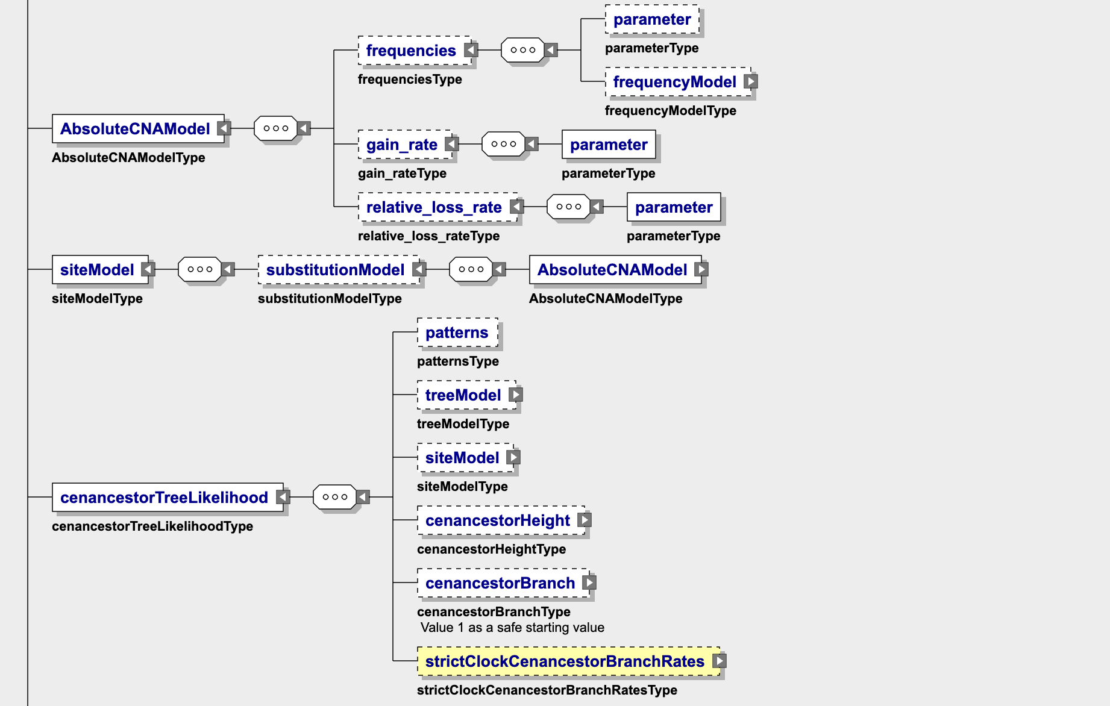
Example 1 strict clock with constant pop size
AbsoluteCNA (Copy/paste)
Site model (c/p)
CenancestroTL (Make sure strict clock inherited)
Change luca_branch and luca_height prior values
Important priors in here luca_branch and luca_height manually change

Slide 20
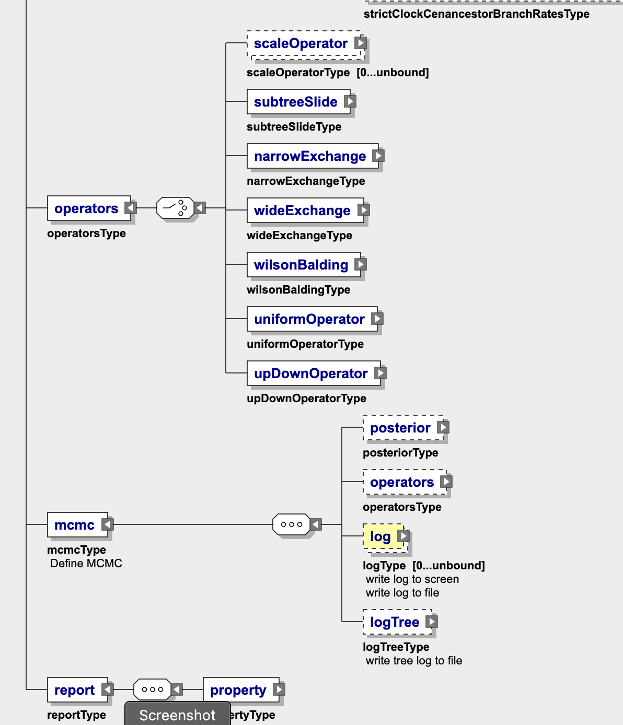
Example 1 strict clock with constant pop size
Trivial mostly unchanged at end
(Can edit number of mcmc generations and log file names)

Slide 21
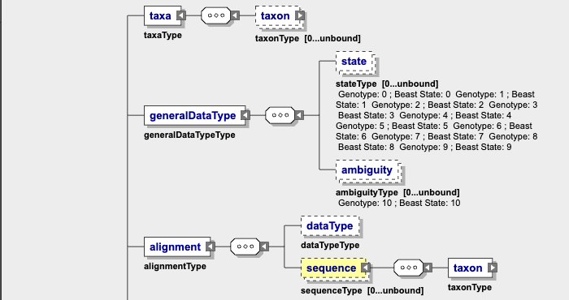
Example 2 strict clock, exponential growth
Taxa block copy and pasted from R
General data type unchanged
Alignment block copy and pasted from R

Slide 22
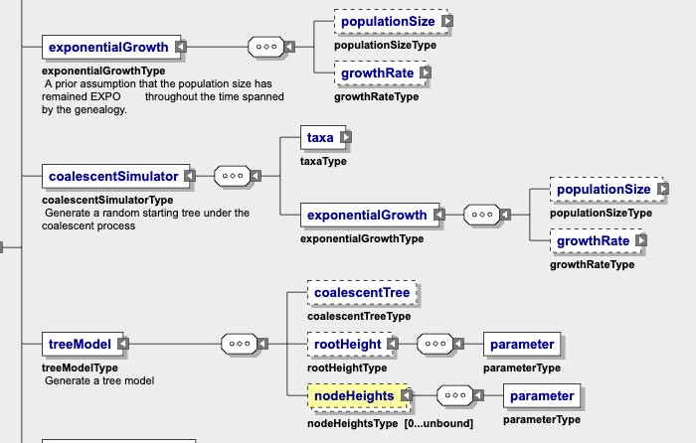
Example 2 strict clock, exponential growth
Exponential growth block copy paste
Coalescent sim (make sure inherits exp growth)
Tree model copy paste

Slide 23
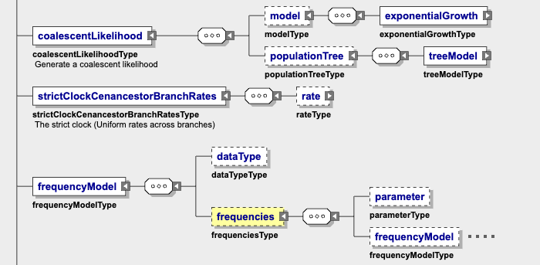
Example 2 strict clock, exponential growth
Coalescentlik copy paste (inherit exp growth)
Strict clock copy paste
Freq model copy paste

Slide 24
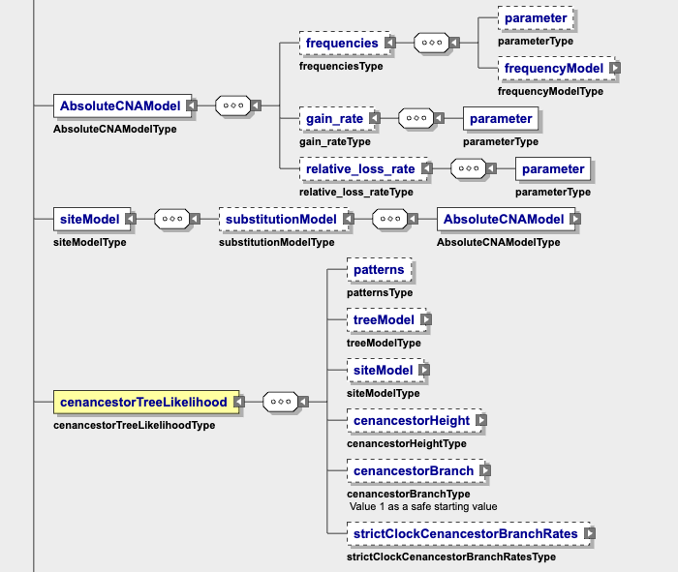
Example 2 strict clock, exponential growth
AbsoluteCNA model copy paste
Site model copy paste
CenTreelik (make sure inherit strict clock, change priors on luca_branch and luca_height)
Important priors in here luca_branch and luca_height manually change

Slide 25
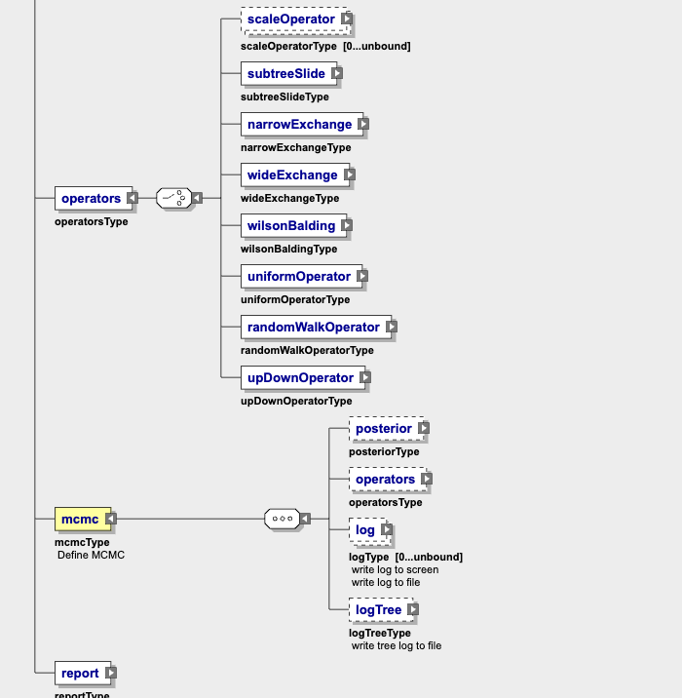
Example 2 strict clock, exponential growth
Copy paste the rest
(Can edit number of mcmc generations and log file names)

Slide 26
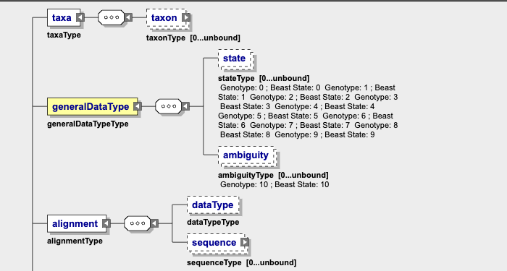
Example 3 random local clock (RLC), constant growth
Same as example 1 and 2
Taxa block and alignment block copy paste

Slide 27
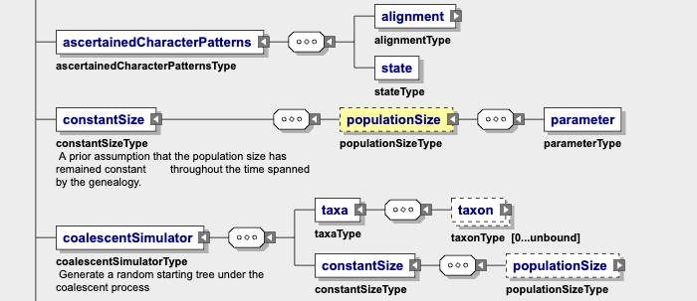
Example 3 random local clock (RLC), constant size
Same as example 1 (constant size)

Slide 28
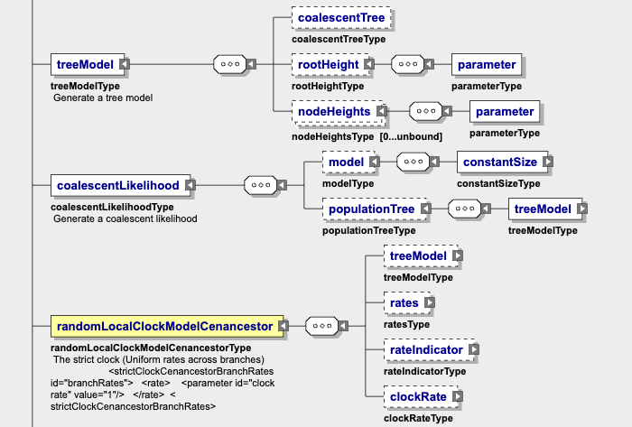
Example 3 random local clock (RLC), constant size
TreeModel unchanged
CoalesecntLike (inherits Constant size)
Rlc specific block

Slide 29
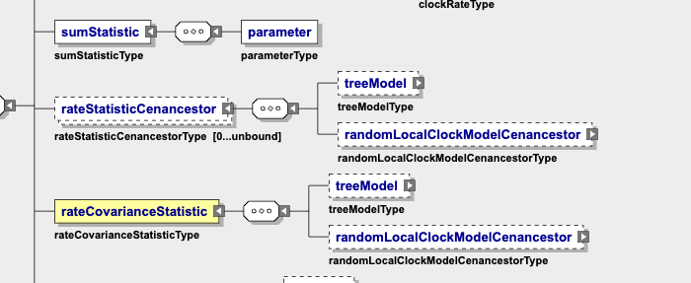
Example 3 random local clock (RLC), constant size
Rlc specific blocks

Slide 30
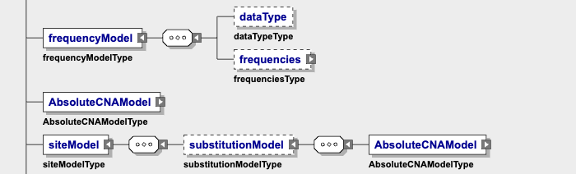
Example 3 random local clock (RLC), constant size
Unchanged blocks

Slide 31
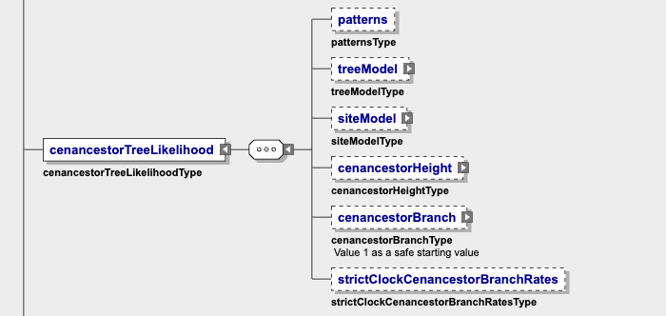
Example 3 random local clock (RLC), constant size
Cenancestor inherits strict clock
Luca_branch and luca_height priors
Important priors in here luca_branch and luca_height manually change

Slide 32
Example 3 random local clock (RLC), constant size
Cenancestor inherits strict clock
Luca_branch and luca_height priors
Important priors in here luca_branch and luca_height manually change

Slide 33
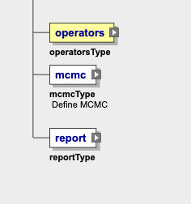
Example 3 random local clock (RLC), constant size
Copy paste

Slide 34
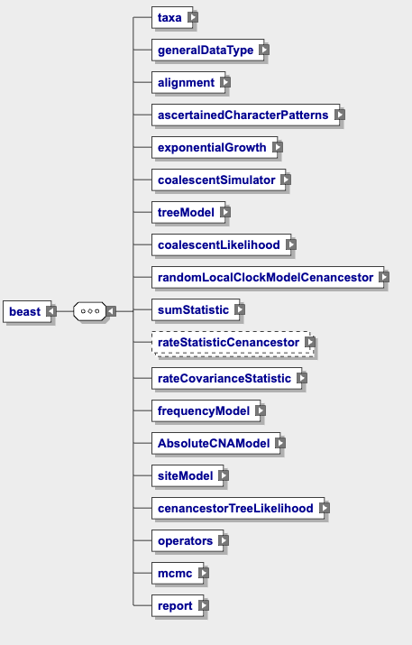
Example 4 RLC, exponential growth

Slide 35
Blocks that are unchanged every time
generalDataType
AscertainedCharacterPatterns
treeModel (check)
frequencyModel
AbsoluteCNAModel
siteModel
Operators
Mcmc
Report
(can change some numbers and log file name)

Slide 36
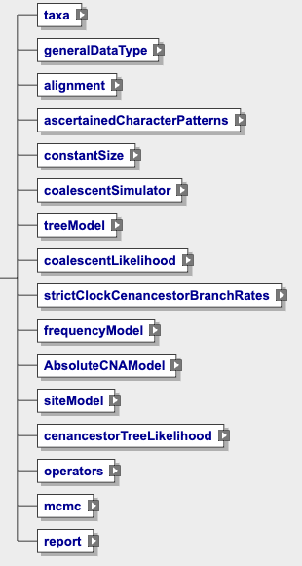
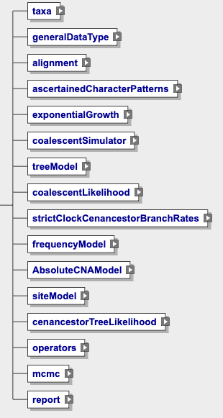
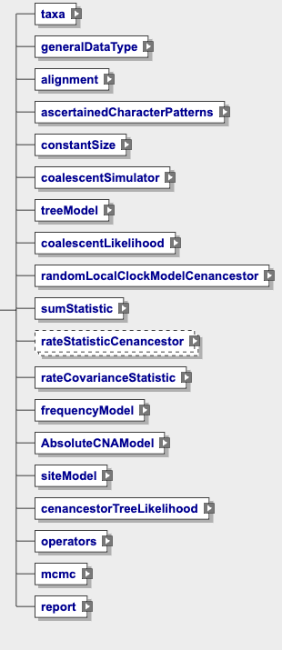
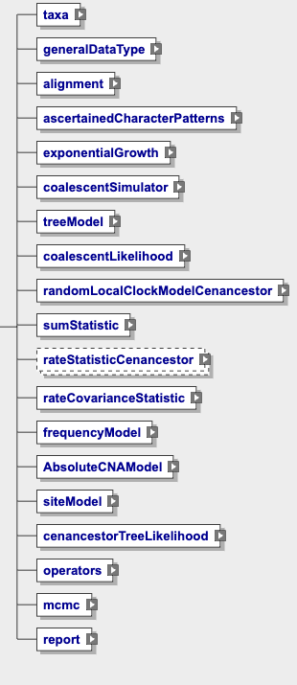
1. Strict-constant
2. Strict –exp
3. rlc-consant
4. rlc-exp

Slide 37
Data blocks
1 taxa block
2 alignment block

Slide 38
Pisca specific
Clock (strict or rlc) (see example 1 vs 3)
randomLocalClockModelCenancestor // strictClockModelCenancestor
rateStatisticCenncestor
CenancestorTreeLikelihood [anything with ‘cen’Definitely pisca specific]
2. Pop model (constant or exponential) (see example 1 vs 2)
constantSize/exponential growth [Might be the same as beast 1.8]
3. Priors for luca_branch and luca_height
cenancestorTreeLikelihood [cen = pisca specific]

